Slide 1


POWER SYSTEMS
Roshan Alex
Department of electrical engineering
College of engineering Trivandrum

Slide 2
Syllabus
Module I (9 Hours)
Power System evolution–Load curve -Load factor, diversity factor, Load curve (brief description only) - Numerical Problems. Generation-conventional (block schematic details, special features, environmental and ethical factors, advantages, disadvantages) -hydro, thermal, nuclear –renewable energy(block
schematic details, special features, environmental factors, regulations, advantages, disadvantages) –solar and wind –Design of a rooftop/ground mounted solar farm (concepts only) – Energy storage systems as alternative energy sources- grid storage systems- bulk power grids –smart grids – micro grids.
Module II (10 hours)
Power Transmission System(Electrical Model)-Line parameters -resistance- inductance and capacitance (Derivation of three phase double circuit) - Transmission line modelling classifications -short line, medium line, long line- transmission line as two port network parameters- derivation and calculations

Slide 3
Syllabus
Module III (10 hours)
Power Transmission System-Calculation of Sag and tension-Insulators –string efficiency grading–corona-Characteristics of transmission lines-Surge Impedance Loading- Series and shunt compensation. Underground cables-ratings- classification- Capacitance –grading-testing. Introduction to EHVAC, HVDC and FACTS: Principle, classification and advantages/disadvantages
Module IV (12 hours)
Switchgear: Need for protection-circuit breakers-rating- SF6,VCB – Principle of GIS protective relays -Demonstration of a typical electromechanical relay - Static, Microprocessor and Numeric types –Principles of overcurrent, directional, distance and differential- Types of protection schemes (Numeric relays) - causes of over voltages–Insulation co-ordination- Communication: PLCC - Fibre Optic-Introduction to IEC61850.
Module V (7 hours)
Power Distribution Systems– Distribution systems- Aerial Bunched Cables –Insulated conductors- Network standards-Earthing- transformer location – balancing of loads. Methods of power factor improvement using capacitors- Tariff mechanisms– Introduction to energy markets (regulated and deregulated systems) -Distribution Automation systems

Slide 4
Evolution of electrical(power) grid
DC GRID
The first complete electric power system (comprising a generator, cable, fuse, meter, and loads) was built by Thomas Alva Edison – (Pearl Street Station in New York City, 1882)
This was a dc system consisting of a steam-engine-driven dc generator, with an initial load of 400 lamps and 82 customers
With the development of motor by Frank Sprague in 1884, motor loads were added to such systems
AC GRID
The development of the transformer by L. Gaulard and J.D. Gibbs led to rise of ac power systems. George Westinghouse secured rights to these developments in the United States.
Long distance transmission was introduced
With the development of polyphase systems, the ac system became even more attractive.

Slide 5
Evolution of electrical(power) grid
AC vs DC [Westinghouse vs Edison]
In the 1890s, there was considerable controversy over whether the electric utility industry should be standardized on dc or ac.
By the turn of the century, the ac system had won out over the dc system for the following reasons:
Voltage levels can be easily transformed in ac systems
AC generators and motors are much simpler than dc generators and motors
In the early period of ac power transmission, frequency was not standardized. (25, 50, 60, 125)
Development of mercury arc valves in the early 1950s, high voltage dc (HVDC) transmission systems became economical in special situations.

Slide 6
Evolution of National Grid
Grid management on regional basis started in sixties.
State grids were inter-connected to form regional grids
India was demarcated into 5 regions namely Northern, Eastern, Western, North Eastern and Southern region.
In October 1991 North Eastern and Eastern grids were connected.
In March 2003 WR and ER-NER were interconnected.
In August 2006 North and East grids were interconnected thereby 4 regional grids Northern, Eastern, Western and North Eastern grids are synchronously connected
On 31st December 2013, Southern Region was connected to Central Grid in synchronous mode with the commissioning of 765kV Raichur-Solapur Transmission line.
'ONE NATION'-'ONE GRID'-'ONE FREQUENCY’
Synchronization of all regional grids will help in optimal utilization of scarce natural resources by transfer of power from resource centric regions to load centric regions.

Slide 7
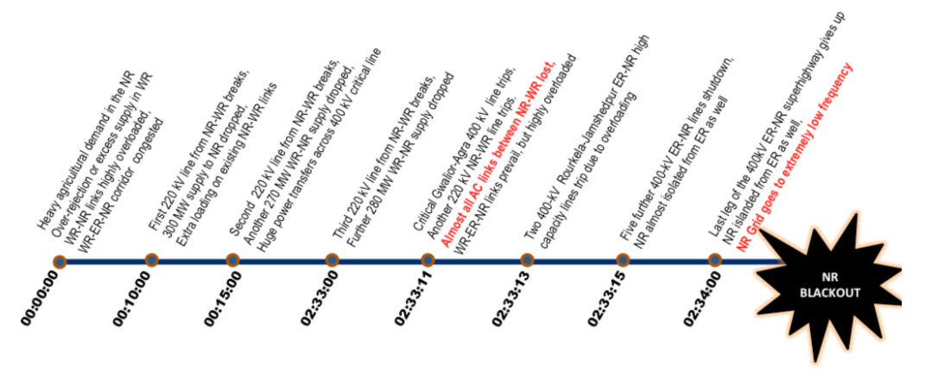

Slide 8
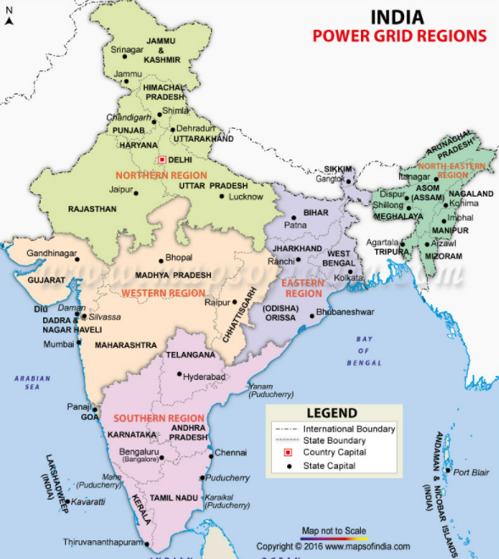
Evolution of National Grid

Slide 9
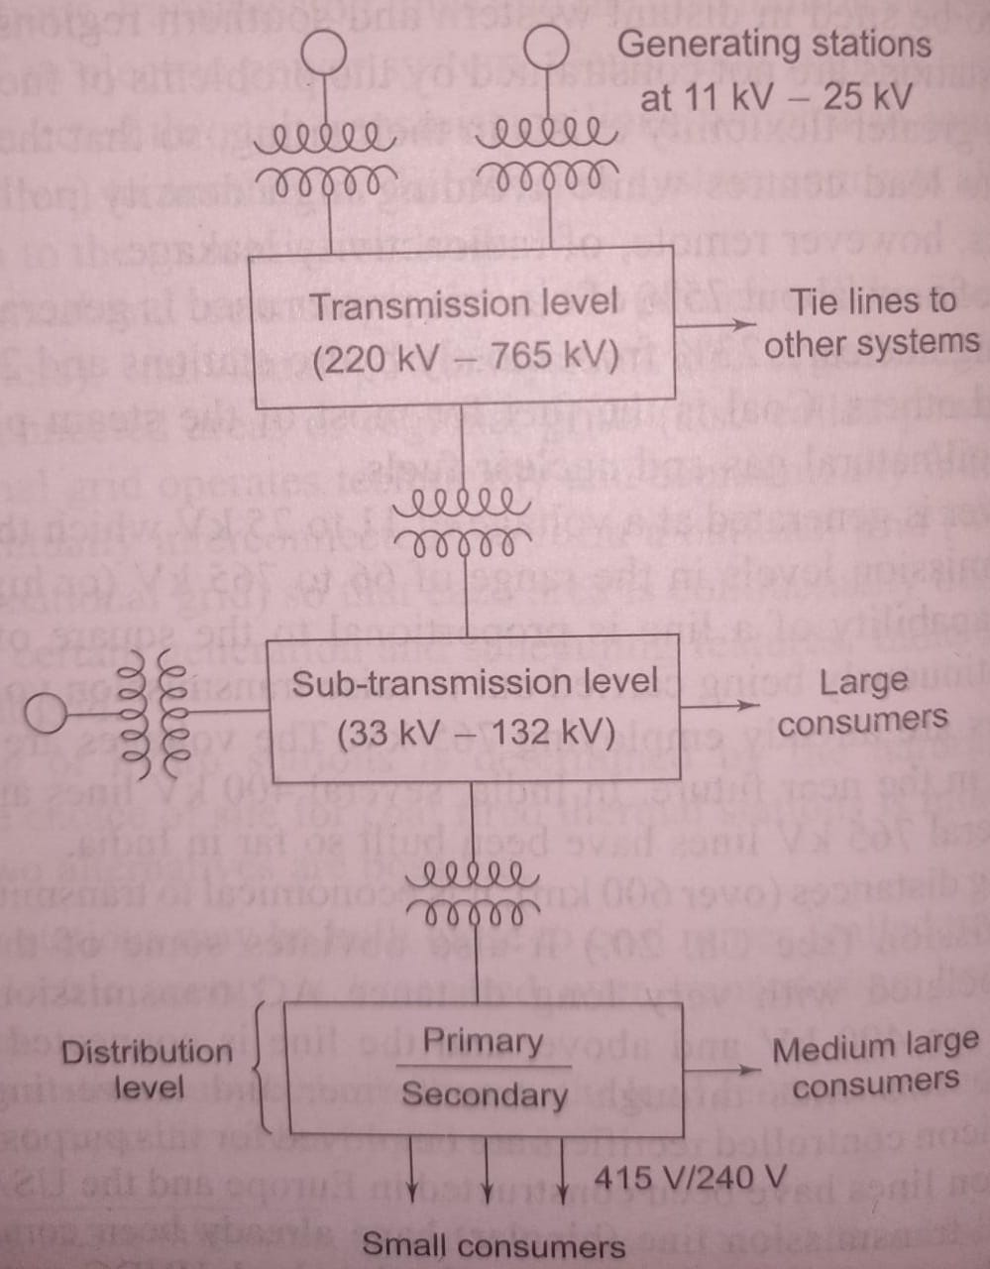
Schematic diagram of power system

Slide 10
CONVENTIONAL & NON-CONVENTIONAL SOURCES OF ENERGY
Energy that has been used since initial stages of energy production are known as conventional energy.
Conventional energy sources include fossil fuels (coal, petroleum and natural gas), water and nuclear energy.
Fossil fuels are also used as raw materials in the chemical industry
They leave behind harmful by-products upon combustion, hence causing pollution and global warming
They are non-renewable and fast depleting
The sources of energy which are being produced continuously in nature are called renewable sources or non-conventional sources of energy.
Non-Conventional energy sources include solar, wind, geothermal, tidal, etc.
They are inexhaustible and available in nature free of cost.
Non-Conventional energy sources do not pollute the atmosphere.
Availability is uncertain. The energy flow depends on various natural phenomena

Slide 11
Generating Stations
Bulk electric power is produced by special plants known as generating stations or power plants.
A generating station essentially employs a prime mover coupled to an alternator for the production of electric power.
The prime mover (e.g. Steam turbine, water turbine etc.) converts energy from some other form into mechanical energy.
The alternator converts mechanical energy of the prime mover into electrical energy.
A modern generating station employs several auxiliary equipment and instruments to ensure cheap, reliable and continuous service.
Depending upon the form of energy converted into electrical energy the generating stations are classified as under :
(i) Steam power stations (ii) Hydroelectric power stations
(iii) Diesel power stations (iv) Nuclear power stations

Slide 12
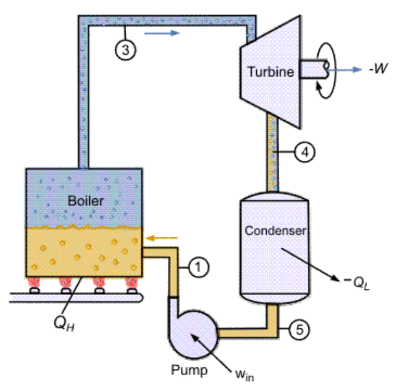
Steam Power Station (Thermal Station)
Converts heat energy of coal combustion into electrical energy
The steam power station basically works on the Rankine cycle
Steam is produced in the boiler by utilizing the heat of coal combustion.
Steam is then expanded in the prime mover (i.e., steam turbine) and is
condensed in a condenser to be fed into the boiler again.
Steam turbine drives the alternator which converts mechanical energy of
the turbine into electrical energy.
Suitable where coal and water are available in abundance and a large amount of electric power is to be generated.
ADVANTAGES
Of all the fossil fuel sources, coal is the least expensive for its energy content.
Less initial cost as compared to other generating stations.
Requires less space as compared to the hydroelectric power station.

Slide 13
Steam Power Station (Thermal Station)
It can be installed at any place irrespective of the existence of coal.
DISADVANTAGES
It pollutes the atmosphere
It is costlier in running cost as compared to hydroelectric plant.
SCHEMATIC ARRANGEMENT OF STEAM POWER STATION
The whole arrangement can be divided into the following stages for the sake of simplicity :
1. Coal and ash handling arrangement 2. Steam generating plant
3. Steam turbine 4. Alternator
5. Feed water 6. Cooling arrangement
Coal and ash handling plant
Coal is transported to the power station by road or rail and stored in the coal storage plant.

Slide 14
Steam Power Station (Thermal Station)
From the coal storage plant, coal is delivered to the coal handling plant where it is pulverized in order to increase its surface exposure.
The pulverized coal is fed to the boiler by belt conveyors
Ash produced after the complete combustion of coal is removed to the ash handling plant and then delivered to the ash storage plant for disposal.
Steam generating plant
The steam generating plant consists of a boiler for the production of steam and other auxiliary equipment for the utilization of flue gases.
(i) Boiler- The heat of combustion of coal in the boiler is utilized to convert water into steam at high temperature and pressure. The flue gases from the boiler make their journey through superheater, economizer, air pre-heater and are finally exhausted to atmosphere
(ii) Superheater. The steam produced in the boiler is wet and is passed through a superheater where it is dried and superheated by the flue gases on their way to chimney. Overall efficiency is increased and too much condensation in the last stages of turbine is avoided.

Slide 15
(iii) Economiser. An economiser is essentially a feed water heater and derives heat from the flue gases for this purpose.
(iv) Air preheater. An air preheater increases the temperature of the air supplied for coal burning by deriving heat from flue gases. The principal benefits of preheating are : increased thermal efficiency and increased steam capacity per square metre of boiler surface.
Steam turbine
The dry and superheated steam from the superheater is fed to the steam turbine through main valve
After transferring heat energy to the turbine, the steam is exhausted to the condenser which condenses the exhausted steam by means of cold water circulation
Alternator
The steam turbine is coupled to an alternator
The alternator converts mechanical energy of turbine into electrical energy.
Feed water
The condensate from the condenser is used as feed water to the boiler
Some water may be lost in the cycle which is suitably made up from external source

Slide 16
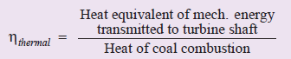
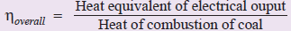
Cooling arrangement
The steam exhausted from the turbine is condensed by means of a condenser
Circulating water obtained from natural sources, take up the heat of the exhausted steam and itself becomes hot.
During the scarcity of water in the river, hot water from the condenser is passed on to the cooling towers where it is cooled.
EFFICIENCY
The overall efficiency of a steam power station is quite low due mainly to two reasons:
(A) huge amount of heat is lost in the condenser (B) heat losses occur at various stages of plant.
The thermal efficiency of a modern steam power station is about 30%.
Overall efficiency = Thermal efficiency X Electrical efficiency (approx. 29%)

Slide 17
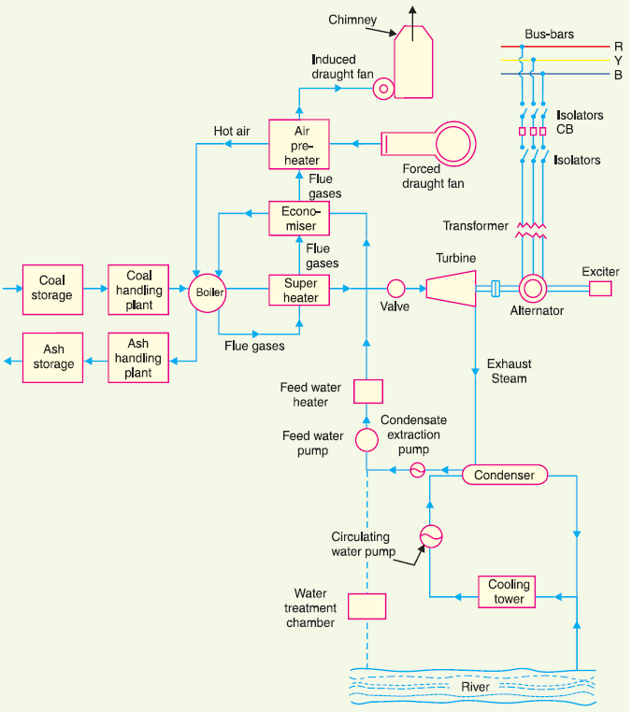

Slide 18
Hydro-electric Power Station
A generating station which utilizes the potential energy of water at a high level for the generation of electrical energy.
Generally located in hilly areas where dams can be built conveniently and large water reservoirs can be obtained
The water turbine captures the energy in the falling water and changes the hydraulic energy into mechanical energy at the turbine shaft.
The turbine drives the alternator which converts mechanical energy into electrical energy.
They have the added importance for flood control, storage of water for irrigation and water for drinking purposes
Advantages
(i) It requires no fuel as water is used for the generation of electrical energy.
(ii) It is quite neat and clean as no smoke or ash is produced.
(iii) It requires very small running charges because water is the source of energy which is available free of cost.

Slide 19
Hydro-electric Power Station
(iv) requires less maintenance.
(v) It does not require a long starting time like a steam power station. In fact, such plants can be put into service instantly.
(vi) It is robust and has a longer life.
(viii) Few experienced persons are needed for operation.
Disadvantages
(i) It involves high capital cost due to construction of dam.
(ii) There is uncertainty about the availability of huge amount of water due to dependence on weather conditions.
(iii) Skilled and experienced hands are required to build the plant.
(iv) It requires high cost of transmission lines as the plant is located in hilly areas which are quite away from the consumers.

Slide 20
References
Principles of power system- V.K Mehta
Power system engineering-Kothari & Nagrath
Non-conventional energy resources –G.S Sawhney
Renewable energy sources and emerging technologies- D.P Kothari

Slide 21
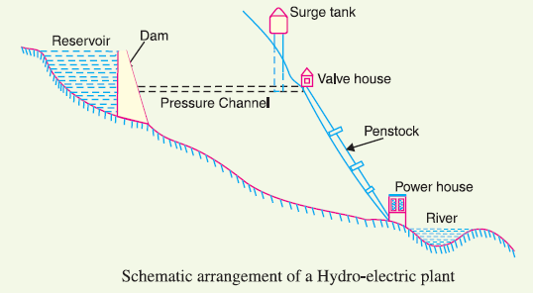
Schematic Arrangement of Hydro-electric Power Station
The dam is constructed across a river or lake and water from the catchment area collects at the back of the dam to form a reservoir
A pressure tunnel is taken off from the reservoir and water brought to the valve house at the start of the penstock.
Main sluice valves controls the water flow to the power house and automatic isolating valves cuts off supply of water when the penstock bursts.

Slide 22
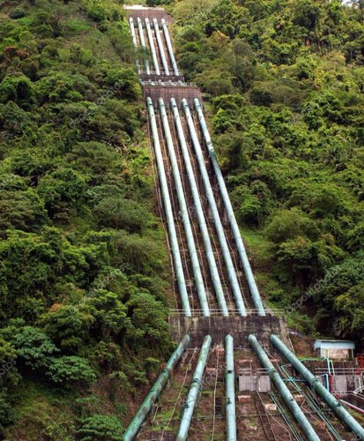
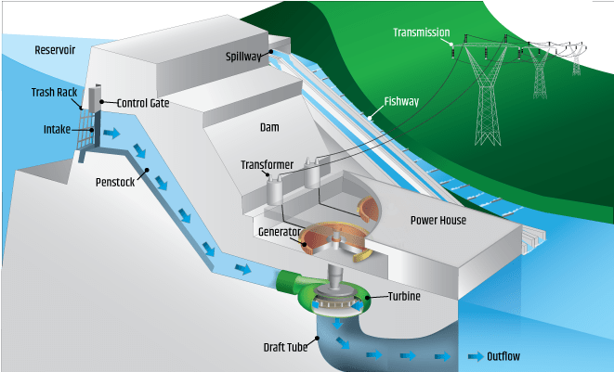
Schematic Arrangement of Hydro-electric Power Station
From the valve house, water is taken to water turbine through a huge steel pipe known as penstock.
The water turbine converts hydraulic energy into mechanical energy and it drives the alternator which converts mechanical energy into electrical energy
A surge tank is built just before the valve house and protects the penstock from bursting in case the turbine gates suddenly close due to electrical load being thrown off.
The surge tank absorbs this pressure swing by increase in its level of water.

Slide 24
Constituents of Hydro-electric Plant
The constituents of a hydro-electric plant are :
(1) hydraulic structures (2) water turbines and (3) electrical equipment
Hydraulic structures
include dam, spillways, headworks, surge tank, penstock and accessory works
Dam
A dam is a barrier which stores water and creates water head.
Dams are built of concrete or stone masonary, earth or rock fill.
The type of dam also depends upon the topography of site, foundation conditions, local materials, transportation available, occurrence of earthquakes and other hazards.
Spillways
There are times when the river flow exceeds the storage capacity of the reservoir
In order to discharge the surplus water from the storage into the river on the down-stream side of the dam, spillways are used.

Slide 25
Constituents of Hydro-electric Plant
Headworks
The headworks consists of the diversion structures at the head of an intake.
They generally include booms and racks for diverting floating debris and valves for controlling the flow of water to the turbine.
The flow of water into and through headworks should be as smooth as possible to avoid head loss and cavitation.
Surge tank
When closed conduits are used, protection becomes necessary to limit the abnormal pressure in the conduit.
Hence, closed conduits are always provided with a surge tank.
A surge tank is a small reservoir or tank (open at the top) in which water level rises or falls to reduce the pressure swings in the conduit.

Slide 26
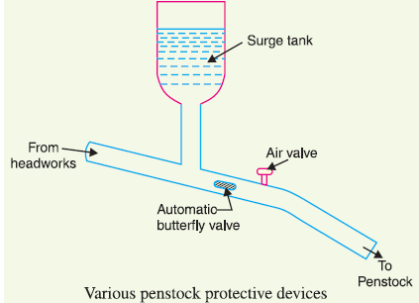
Penstocks
Penstocks are open or closed conduits which carry water to the turbines.
They are generally made of reinforced concrete or steel.
Automatic butterfly valve shuts off water flow through the penstock promptly if it ruptures.
Air valve maintains the air pressure inside the penstock equal to outside atmospheric pressure.

Slide 27
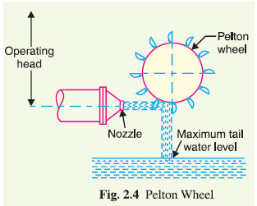
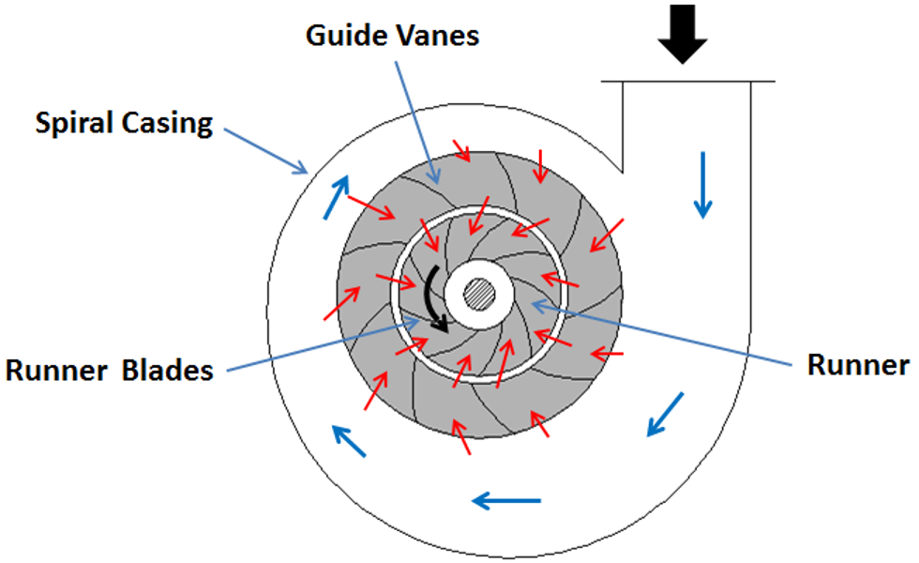
Constituents of Hydro-electric Plant
Water turbines
Water turbines are used to convert the energy of falling water into mechanical energy.
The principal types of water turbines are : (i) Impulse turbines (ii) Reaction turbines
Impulse turbines are used for high heads. e.g. Pelton wheel
In an impulse turbine, the entire pressure of water is converted into kinetic energy in a nozzle and the velocity of the jet drives the wheel.
It consists of a wheel fitted with elliptical buckets along its periphery
Reaction turbines are used for low and medium heads. E.g. Francis, Kaplan
In a reaction turbine, water enters the runner partly with pressure energy and partly with velocity head.
It consists of an outer ring of stationary guide blades fixed to the turbine casing and an inner ring of rotating blades forming the runner.
The guide blades control the flow of water to the turbine.

Slide 28
Constituents of Hydro-electric Plant
Electrical equipment
The electrical equipment of a hydro-electric power station includes alternators, transformers, circuit breakers and other switching and protective devices.
Problem
A hydro-electric generating station is supplied from a reservoir of capacity 5x10⁶ cubic metres at a head of 200 metres. Find the total energy available in kWh if the overall efficiency is 75%. (density=1000 kg/m³)
ANS: 7.36x10¹² Ws

Slide 29
Nuclear Power Station
A generating station in which nuclear energy is converted into electrical energy is known as a nuclear power station.
Heavy elements such as Uranium (U²³⁵) or Thorium (Th²³²) are subjected to nuclear fission in a special apparatus known as a reactor.
The heat energy released during fission is utilized in creating steam at high temperature and pressure.
Huge amount of electrical energy can be produced from a relatively small amount of nuclear fuel.
Advantages
considerable saving in the cost of fuel transportation
requires less space as compared to any other type of the same capacity
low running charges as a small amount of fuel is used
very economical for producing bulk electric power
it can be located near the load centres
large deposits of nuclear fuels available all over the world
It ensures reliability of operation

Slide 30
Disadvantages
fuel used is expensive and is difficult to recover
capital cost on a nuclear plant is very high
erection and commissioning of the plant requires greater technical know-how
fission by-products are generally radioactive and lethal
maintenance charges are high
not well suited for varying loads as the reactor does not respond to the load fluctuations efficiently
disposal of the by-products is a big problem

Slide 31
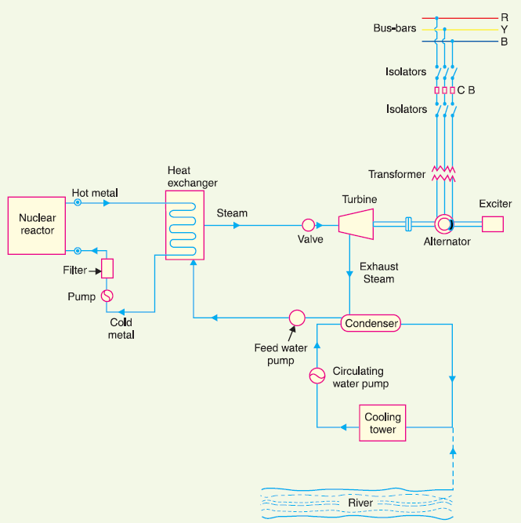
Schematic Arrangement of Nuclear Power Station
The whole arrangement can be divided into the following main stages :
(i) Nuclear reactor (ii) Heat exchanger (iii) Steam turbine (iv) Alternator
Nuclear reactor
It is an apparatus in which nuclear fuel is subjected to to nuclear fission
It controls the chain reaction that starts once the fission is done
A nuclear reactor is a cylindrical stout pressure vessel and houses fuel rods of Uranium, moderator and control rods
Fuel rods constitute the fission material and release huge amount of energy when bombarded with slow moving neutrons
Moderator slows the neutrons before bombarding fuel rods
Control rod made of cadmium is strong neutron absorber and thus regulates the supply of neutrons for fission

Slide 32
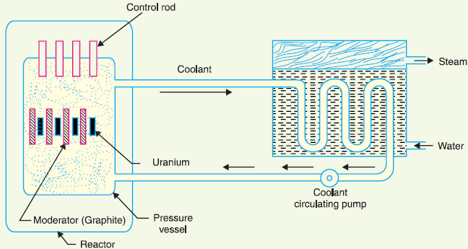
By pulling out the control rods, power of the nuclear reactor is increased, and by pushing them in, it is reduced.
The coolant carries the heat to the heat exchanger.
Heat Exchanger
The coolant gives up heat to the heat exchanger which is utilized in raising the steam.
Steam turbine
The steam produced in the heat exchanger is led to the steam turbine through a valve.
The condenser condenses the steam which is fed to the heat exchanger through feed water pump.
Alternator
The steam turbine drives the alternator which converts mechanical energy into electrical energy.
The output from the alternator is delivered to the bus-bars through transformer, circuit breakers and isolators.

Slide 33
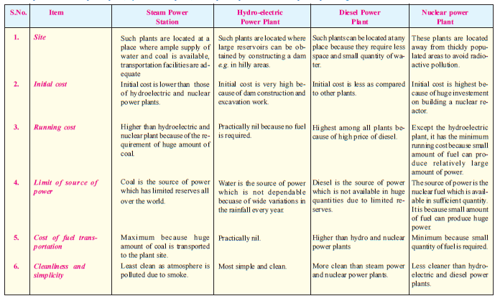
Comparison

Slide 34
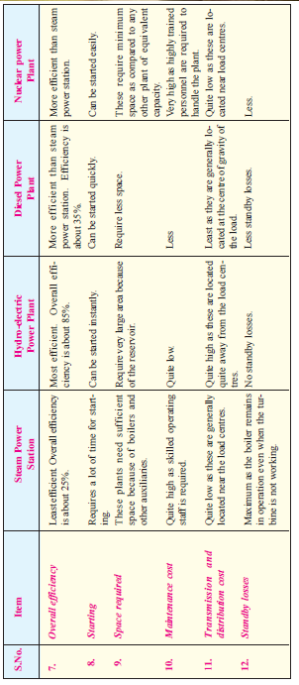
Comparison

Slide 35
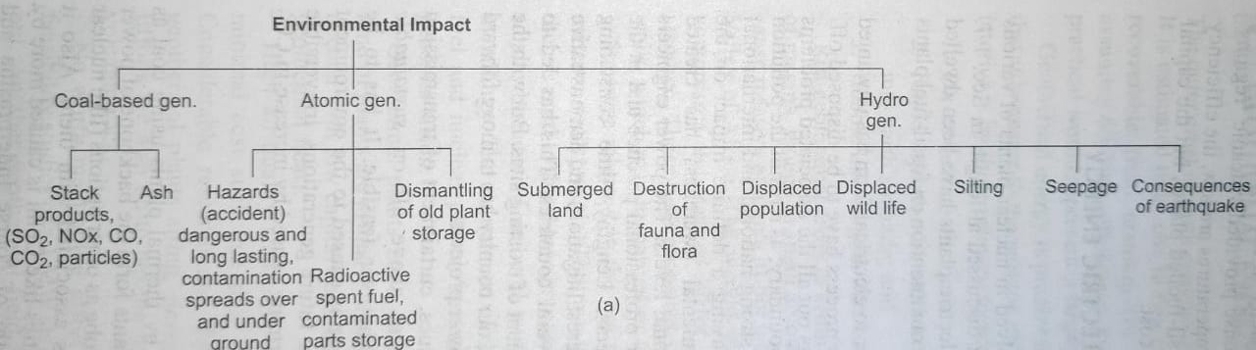
Environmental aspects
Power engineers must be fully aware of the environmental impact and ethical aspects of various projects
Emphasis must be laid on conservation issues, reduction of losses, theft, subsidized power supplies and sustainable development
Coal-based generation
Backbone of power generation in India

Slide 36
Environmental aspects
Pollution and pollutants have no geographical boundary
Problematic pollutants in emission of coal-based plants:
Oxides of sulphur (SO₂)
Sulphur present in fossil fuels –> oxidized to SO₂ in combustion chamber –> oxidized to H₂SO₄ and metallic sulphates –> acid rain, impaired visibility, damage to vegetation & buildings
Health issues: asthma, lung and heart disease
Solution: Remove sulphur from coal by gasification or floatation process, Use of limestone scrubbers or fluidized bed combustion
Oxides of nitrogen (NO_{x})
NO₂ is a major pollutant
Soluble in water and combine with moisture to form nitrous and nitric acids.
Health issues: Bronchitis, pneumonia

Slide 37
Environmental aspects
Solution: controlled by fitting advanced technology burners, removed from combustion products by absorption process by certain solvents.
Oxides of carbon( CO, CO₂)
CO is very toxic
CO₂ is a major cause of global warming
Prolonged significant exposure to carbon monoxide can cause serious complications, including brain damage and heart problems.
Maintaining and servicing appliances, chimneys and flues
Fly ash
Dust content is high in Indian coal
Particulates come out of the plant in the form of fly ash
It comprises particles of carbon, ash and inert materials

Slide 38
Health issues: Poor visibility, respiratory diseases
Solution: precipitators used to remove fine particles as flue gases rise up the stack.
Thermal pollution:
Temperature of water used for cooling process will be increased which inturn threatens sea and river life
Raising humidity to high levels in surrounding areas.
Nuclear Plants
From nuclear reactor there is a continuous emission of α,β, and γ particles
Nuclear waste are highly radioactive and have a long half life.(¹³¹I= 8 days, ⁹⁰Sr=28.8 years)
Design and construction of reactors must be able to handle every contingency

Slide 39
Many facilities (e.g. control system) are atleast duplicated and have alternative energy supplies.
The effects of radioactive exposure of population includes: appearance of burns, red lesions and sores, cancer, leukaemia, anaemia, haemorrhage, a decline in the lifespan leading to premature ageing, premature death and genetic disorders.
Infertility of Soil, adverse effects on plant Life
Radioactive wastes are concentrated in liquid form and stored in stainless steel containers
Currently, burying nuclear wastes deep underground seems to be best way to dispose wastes.
The burial location must be geologically stable, should not be earthquake prone, not near to ground water.
Health control and safety protocols are much more rigorous than any other industry.

Slide 40
Hydroelectric plant
Hydroelectric reservoir has an extreme environmental impact: destroys forest, wildlife habitat, agricultural land, etc.
It has a major impact on aquatic ecosystems.
Reservoir water is usually more stagnant than normal river water , which can lead to an excess of algae and other aquatic weeds.
GHG such as carbon dioxide and methane form in human-made water storage reservoirs (aerobic and anaerobic decomposition of biomass)
People and their livelihoods are affected when the areas where they live and work are affected by a reservoir.
Silting causes the reduction of the dam storage capacity (due to the accumulation of sediments) and reduces its service life
Seepage becomes a concern if it is carrying material with it, and should be controlled to prevent erosion of the various structures

Slide 41
Ethical aspects
Engineers, in the fulfillment of their professional duties, shall:
Hold paramount the safety, health, and welfare of the public.
Perform services only in areas of their competence.
Issue public statements only in an objective and truthful manner.
Act for each employer or client as faithful agents or trustees.
Avoid deceptive acts.
Conduct themselves honorably, responsibly, ethically, and lawfully so as to enhance the honor, reputation, and usefulness of the profession.

Slide 42
Ethical aspects
The production and use of energy gives rise to a wide range of ethical and moral issues.
Responsibilities towards future generations and preserving non-renewable resources
by-products of fossil fuel combustion pose hazards to both present and future generations.
Improper disposal of nuclear wastes can jeopardize the health and safety of countless future generations.
ethical concerns of international peace and security.
Ethical challenges are faced ethical by renewable resources too
Safer and cleaner energy sources will more likely be available to wealthy countries and individuals

Slide 43
equality and fairness in the distribution of alternative energy sources
Conservation of energy and improving energy efficiency
Use and adapt latest technologies which can reduce impact on environment
Importance to the safety and well-being of the workers & public
Competent management and timely maintenance and inspection.
Sustainable development: Sustainable development is an organizing principle for meeting human development goals while simultaneously sustaining the ability of natural systems to provide the natural resources

Slide 44
SOLAR ENERGY
A major source of renewable energy is solar radiation being cyclically received by the earth.
Various manifestations of solar energy are:
Direct use
Winds on the earth
Potential energy of rain and snow at high altitudes
Biofuels
Ocean temperature difference
Solar energy- Naturally occurring, eco-friendly, lessens GH effect
Currently, solar energy is used as supplement to the conventional grid.

Slide 45
Solar energy (Contd..)
Energy is continuously produced in the sun through nuclear fusion reactions
H₂ + H₂ He + 15 MeV
The mass lost in the process is converted into solar energy
Applications of solar energy
Solar thermomechanical systems: Solar radiation used to heat working fluid which in turn runs the turbine
Solar photovoltaics: SPV convert radiant energy directly into electric current.
Other applications include domestic water heating, solar drying, desalination, industrial process heating, passive/active heating of buildings.

Slide 46
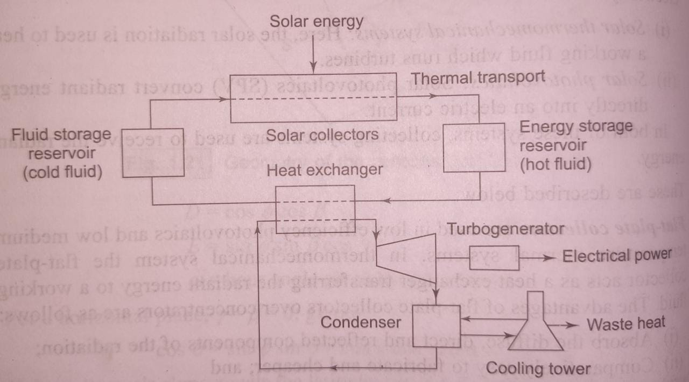
Solar thermochemical systems
Schematic flow diagram for a solar power plant operating on Rankine cycle
Thermal energy of the working fluid gets converted into shaft work by the turbine
Usually a fossil fuel heat source is present as standby
The maximum theoretical thermal efficiency, the ratio of useful work done to the heat supplied is considerably less ( ≈ 30%)

Slide 47

Solar thermochemical systems
Higher efficiency can be obtained by:
Installing an array of mirrors (heliostats) tracking the sun and concentrating sun rays to a single boiler for creating steam
Use of many individual absorbers tracking the sun unidirectionally and thermal energy transferred by a fluid to central boiler.
Advantages
Non-polluting
Available free of cost in nature
Non-depleting source of energy

Slide 48
Disadvantages
Low efficiency
Efficiency of collecting system decreases as its temperature increases
Require storage because of fluctuating nature of sun’s energy
Mechanical systems need greater maintenance
For reliable system, fossil fuel backup maybe needed

Slide 49
Solar photovoltaics
Initially PV cells had limited use e.g. for isolated and remote energy needs.
Due to reduction in cost, areas of application have increased.
PV cell can be classified in terms of materials: non-crystalline silicon, polycrystalline silicon, gallium arsenide, cadmium telluride, cadmium sulphide ,etc.
In terms of fabrication technology- single crystal growth, ribbon growth, thin-film.
Basic structure of PV cell
Various layers from top to bottom are:
Top layer- glass cover, transparent 90%. Protection from dust, moisture, etc.
Transparent adhesive layer which holds glass cover.
Anti-reflection coating (ARC) to reduce the reflected sunlight to below 5%.

Slide 50
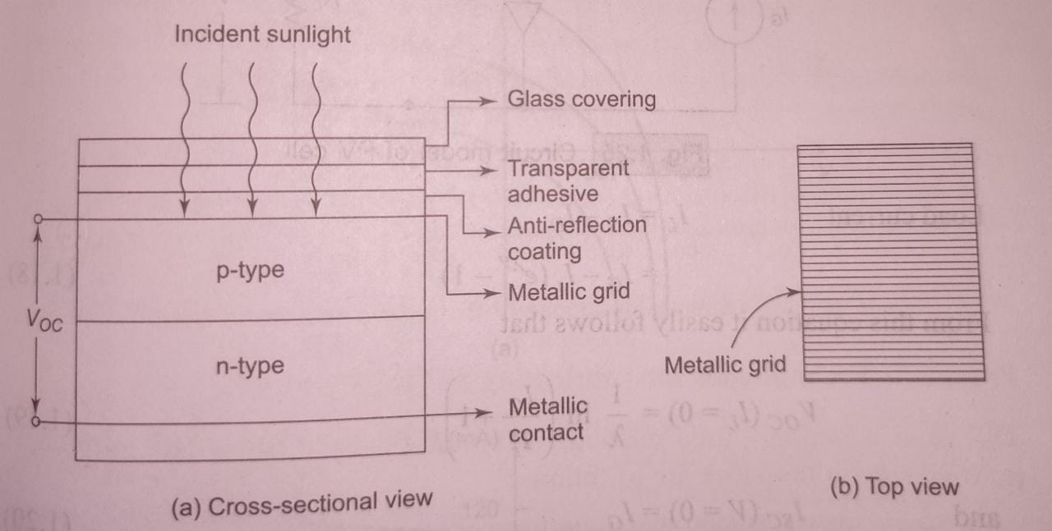
Solar photovoltaics
Metallic grid (aluminum or silver) which collects charge carriers, generated by cell under incidence of sunlight.
Below metallic grid lies a p-layer followed by n-layer forming a p-n junction
Metallic grid in contact with lower n-layer. This forms second terminal of cell.

Slide 51
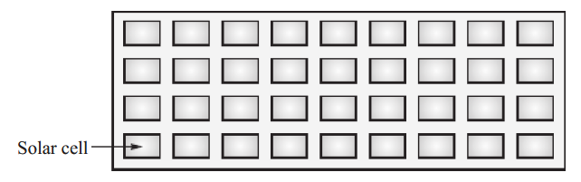
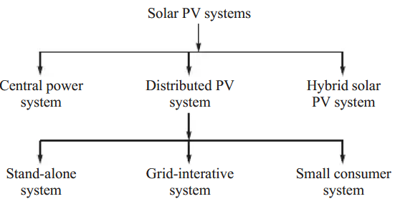
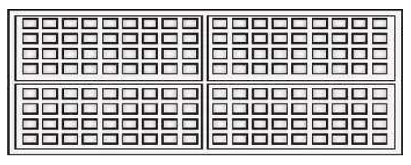
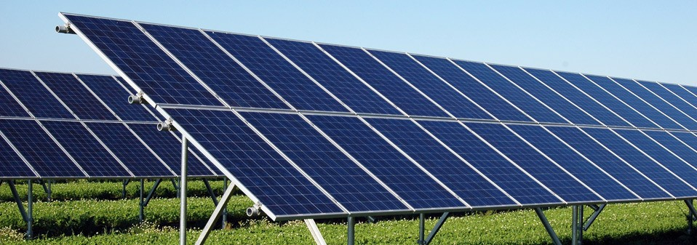
Solar photovoltaics
Solar module
Solar panel
PV array consists of a number of PV panels installed in an array field. No panel should cast shadow on any of the neighboring panels.

Slide 52
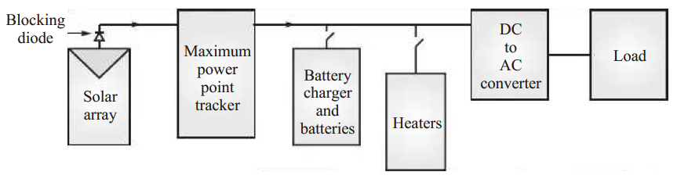
Central Power Station:
Similar to other conventional power stations which are required to feed generated power into some national grid.
This type of solar power stations are designed to meet high peak daytime load only and have large generation capacity in megawatt
Stand-Alone System:
planned and located at the load centre.
complete electricity generation is meant to meet the electrical load of any remote area, village or installation.
Energy storage is essential to meet the requirement during non-sunshine hours.
The solar electric output in direct current is converted into alternating current and it is fed into the load.

Slide 53
Grid interactive solar PV system
the system first meets the requirement of house, village or installation and then all excess power is fed to an electric grid during sunshine hours.
The second advantage of this system is that during absence of insufficient sunshine, the supply of electricity is maintained from the electric grid.
Small consumer systems
power requirement of low energy devices which are generally used for indoor applications, such calculators, watches and electric devices.
Hybrid solar PV system
provide electric power by some other means besides solar electricity.
It is difficult and uneconomical to provide all of the power from only solar PV system.
It may be more economical to meet the power requirement by some other means, such as windmills, fuel cells and diesel or petrol generators.

Slide 54
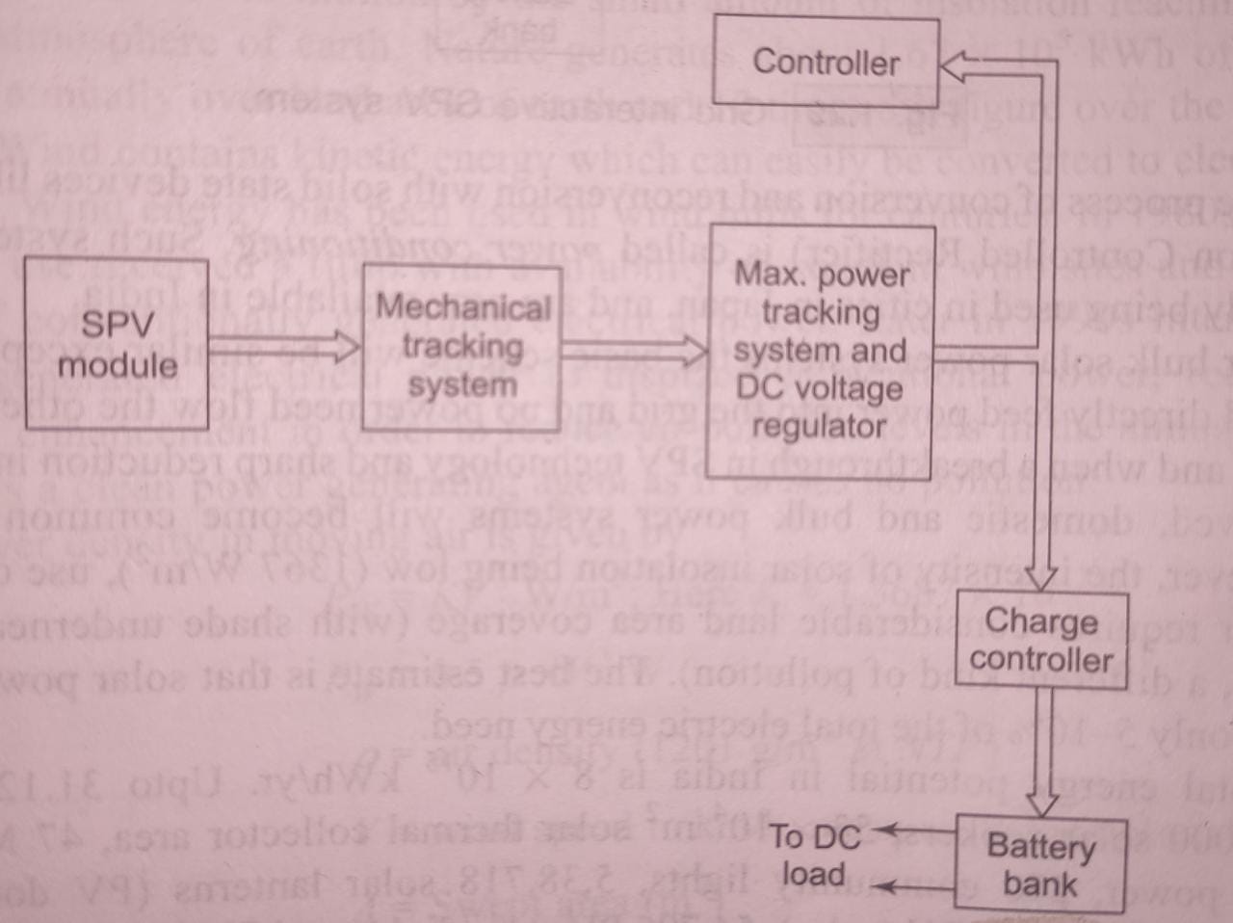
Solar photovoltaics
BULK ENERGY COVERSION BY SPV CELLS
Feasible at bright, clear areas with sun most of the year. (incident solar energy= 2600 kWh/m² annually
SPV cells produce DC power which is max. at a particular point on I-V chara. 3 methods of usage:
Storage in batteries (small systems, reconverting equipment may be needed for end-user)
PV power suitably conditioned to AC form for grid-interactive use (bulk power production)
Combined storage and conditioned AC system
SPV system for feeding DC load with battery storage

Slide 55
Mechanical tracking for orienting SPV module at 90⁰ to incident radiation
Max. power tracking ensures that load draws max. power from SPV module.
DC voltage regulator provides power at rated voltage despite variations in generated voltage and power.
Charge controller protect battery bank from over charging and deep discharging

Slide 56
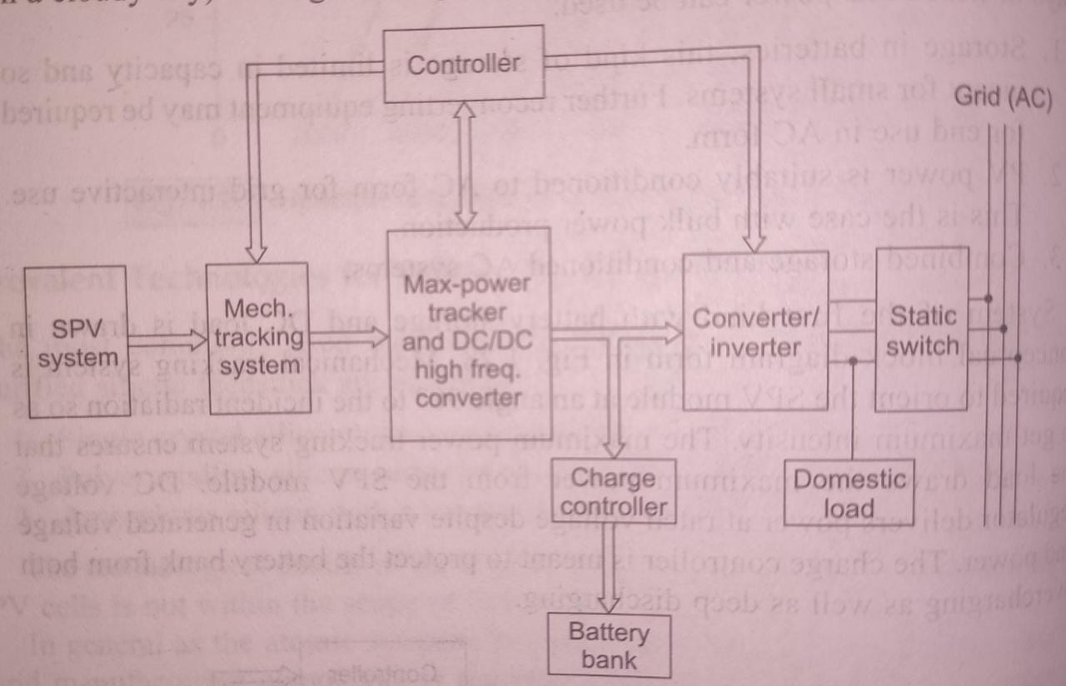
Grid interactive SPV system
Solar cells are connected in series-parallel
DC voltage has to be raised by DC-DC high frequency chopping with an intervening inductor
Converter-Inverter (C-I) is required so that power can flow either way depending upon availability of solar power.
Battery via C-I feeds domestic load at night if grid outage occurs.
For Bulk solar power systems, basic scheme remains similar except that it would directly feed power into the grid and no power flow in opposite direction

Slide 57
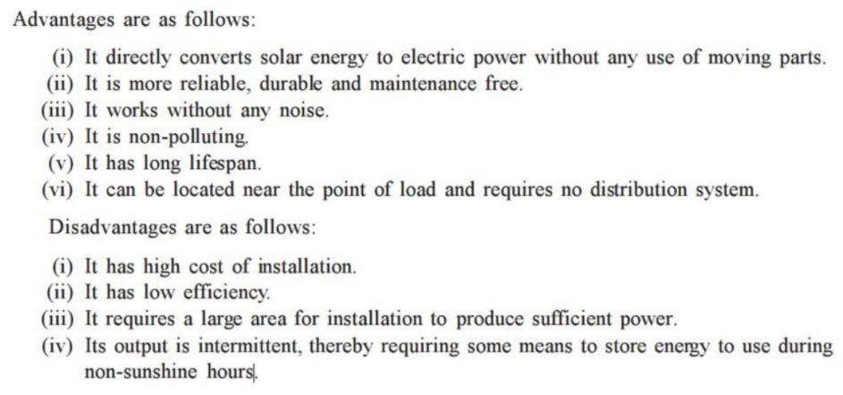
Advantages and disadvantages of PV system

Slide 58
Wind power
Kinetic energy available in the wind is converted to electrical energy by using rotor, gearbox, generator
Plentiful, inexhaustible, renewable, non-polluting
Non-steady and unreliable due to wide variations in speed and direction of wind
It is necessary to store wind energy in some form
Unwieldy size, high structural area, costly.
Varying wind speeds, result in fluctuating voltage and frequency.
Blade pitch control is done by sensing wind speed and automatic adjustment to regulate output is done.
Turning shaft can either power a pump or turn a generator. Larger blades-more wind captured-more power.

Slide 59
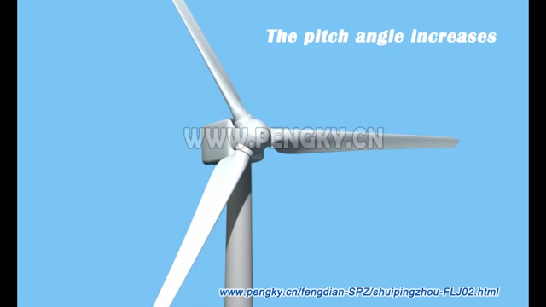
Blade pitch angle control

Slide 60
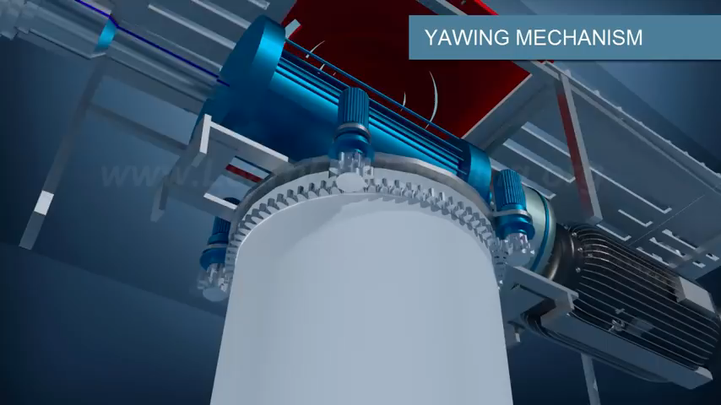
Yawing control

Slide 61
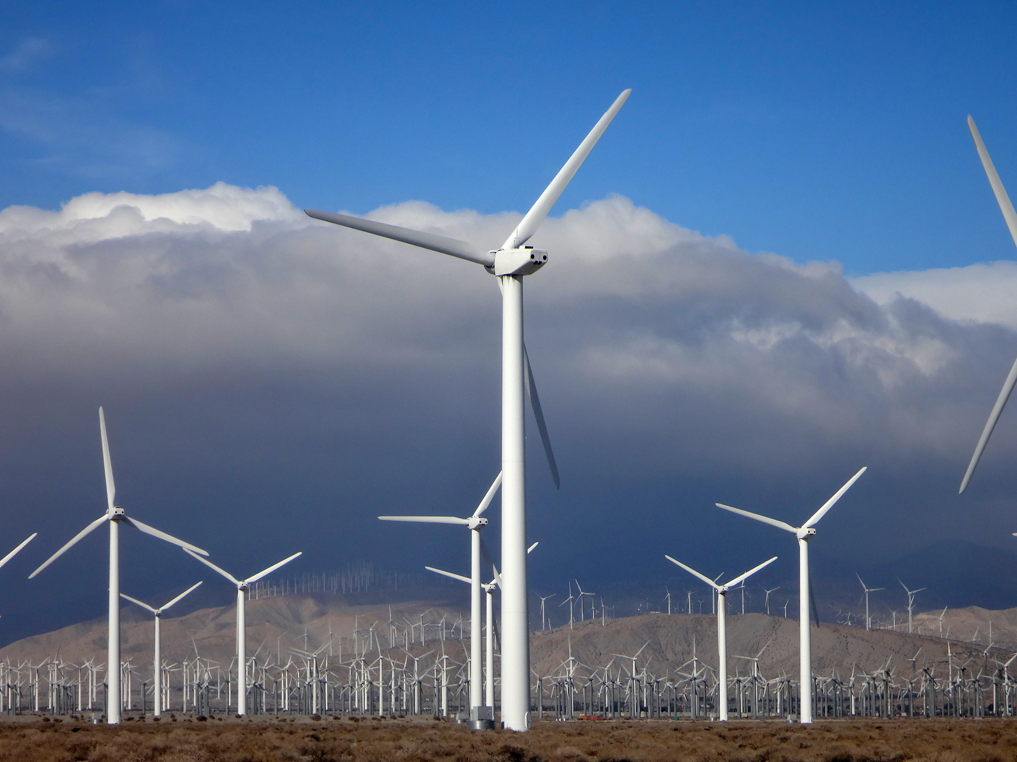

Slide 62
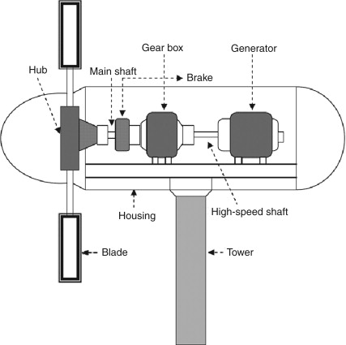
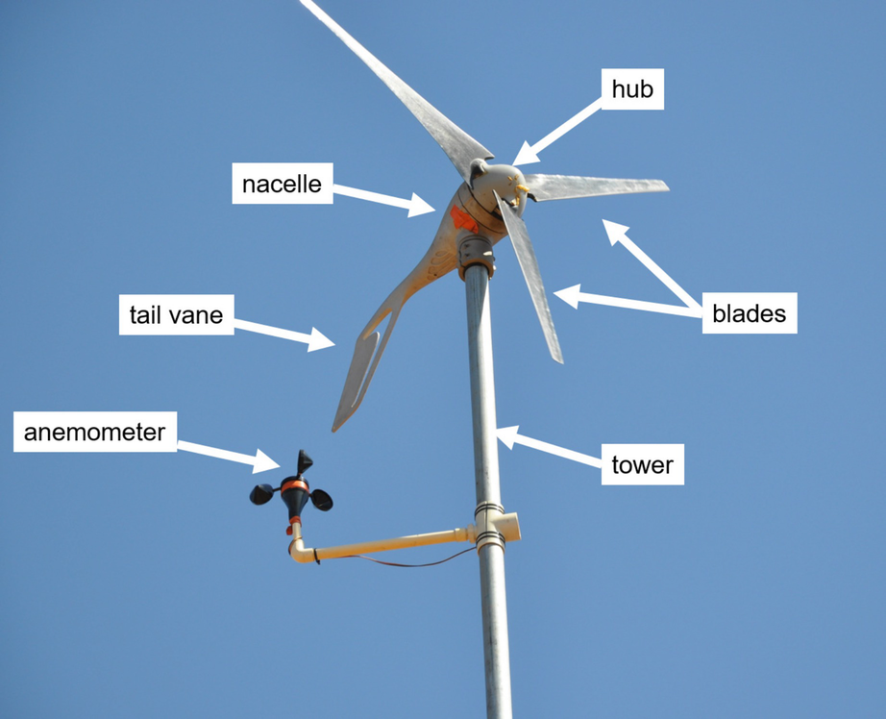
Wind turbines are classified into two general types: Horizontal axis and Vertical axis.
Horizontal axis type is the most common wind turbine design.
A tail vane is usually used to keep the blades facing into the wind.

Slide 63
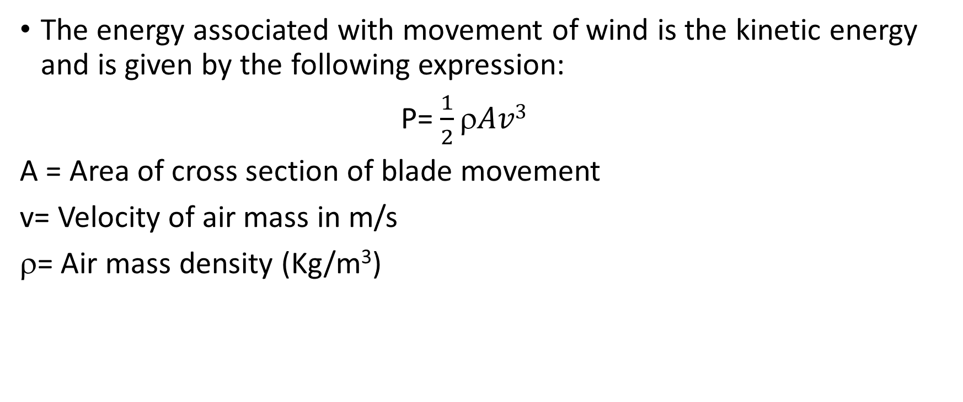
The energy associated with movement of wind is the kinetic energy and is given by the following expression:
P= $\frac{1}{2}ρAv3$
A = Area of cross section of blade movement
v= Velocity of air mass in m/s
$$= Air mass density (Kg/m³)

Slide 64
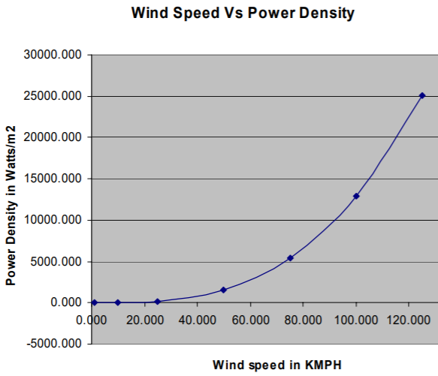
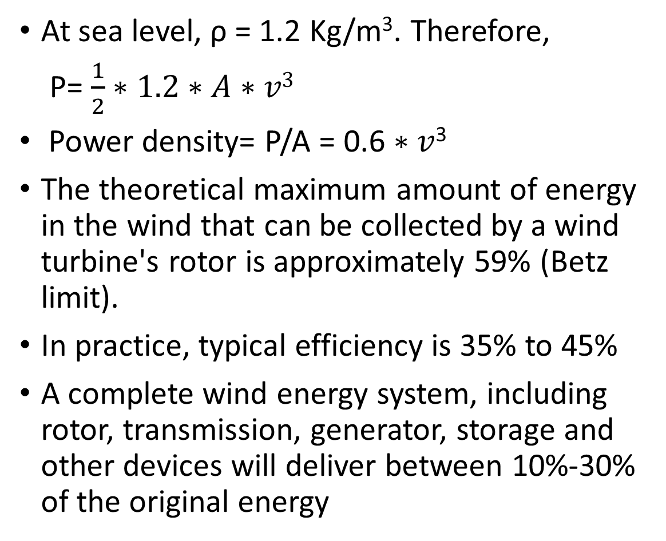
At sea level, ρ = 1.2 Kg/m³. Therefore,
P= $\frac{1}{2}∗1.2∗A∗v3$
Power density= P/A = 0.6 $∗$ $v$³
The theoretical maximum amount of energy in the wind that can be collected by a wind turbine's rotor is approximately 59% (Betz limit).
In practice, typical efficiency is 35% to 45%
A complete wind energy system, including rotor, transmission, generator, storage and other devices will deliver between 10%-30% of the original energy

Slide 65
Wind to electrical energy conversion
Choice of electrical system for an aeroturbine guided by three factors:
Type of electrical output: DC, variable frequency AC , constant frequency AC
Aeroturbine rotational speed: constant speed with variable blade pitch, nearly constant speed with simpler pitch changing mechanism or variable speed with fixed pitch blades
Utilization of electrical output: in conjunction with battery or other form of storage, interconnection with grid
Traditionally, Constant speed constant frequency system with alternator as generating unit is favoured.
With the advent of power electronics technology, it is now possible to use variable speed constant frequency systems.(VSCF)

Slide 66
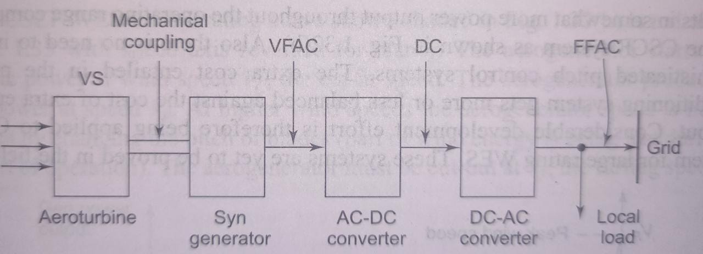
Wind to electrical energy conversion
After the electrical power is generated, it needs to be transmitted to consumers by connecting it to the grid.
Following figure shows how the grid connection is done. It has the following sections:

Slide 67
Advantages of VSCF WES
No complex pitch changing mechanism
Aeroturbine always operates at max. efficiency point
Extra energy in high wind speed region of speed-duration curve can be extracted
Significant reduction in aerodynamic stresses

Slide 68
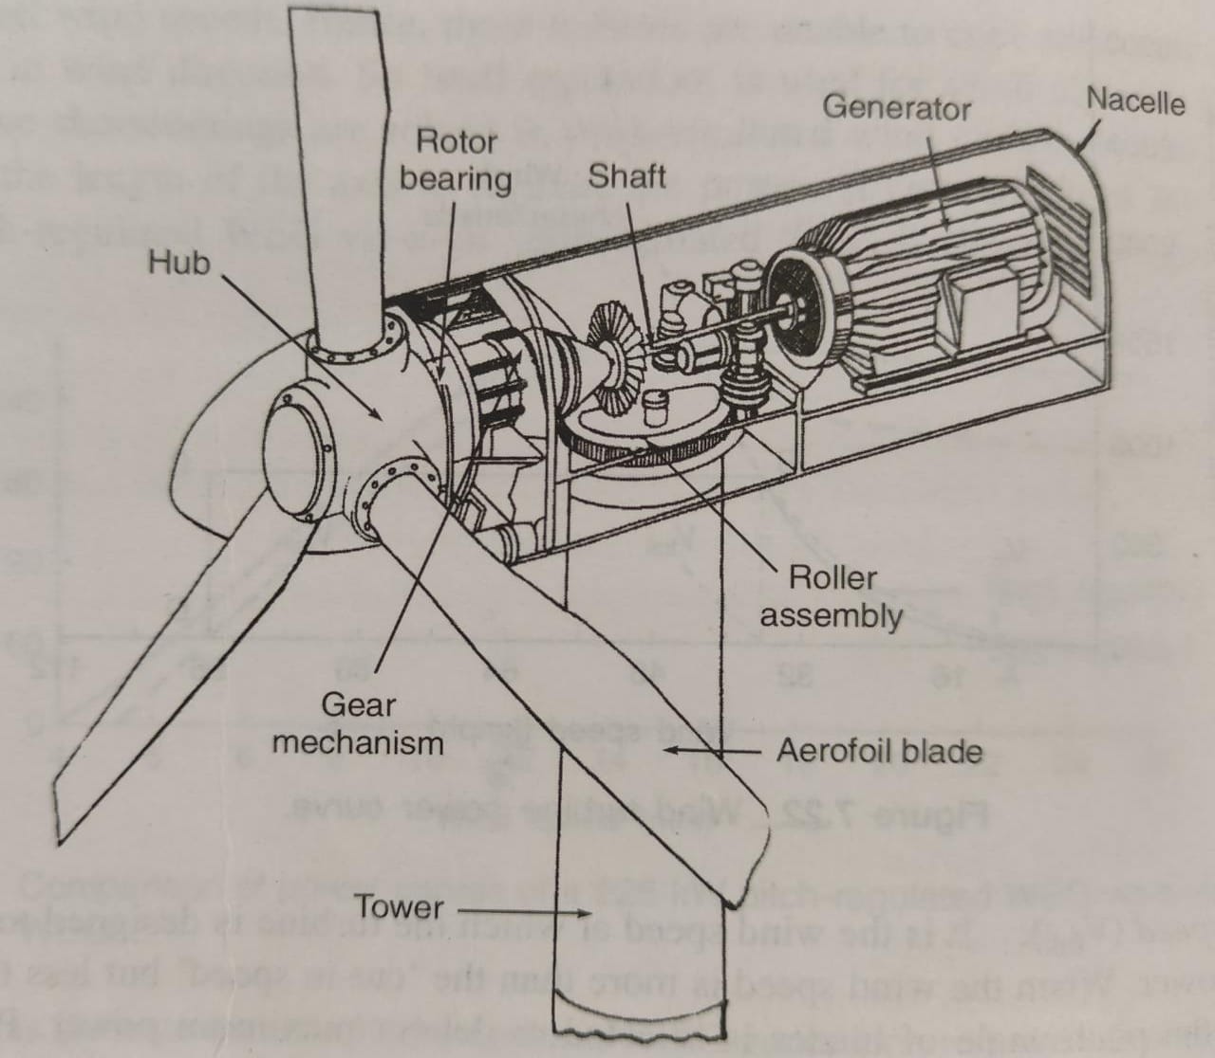
Subsystems of a horizontal axis wind turbine generator
Various subsystems are as follows:
Blades:
lightweight, adequate strength, fabricated with aircraft industry techniques.
glass fibre, reinforced polyester,metal with suitable structural shape to create lift.
Nacelle:
houses generator, gear box and yawing mechanism.
placed at top of the tower
Hub
Central solid portion of rotor is called hub
Helps in the attachment of all blades and pitch angle control mechanism

Slide 69
Subsystems of a horizontal axis wind turbine generator
Power transmission system:
Mechanical power generated by rotor blades is transmitted to generator through two-stage gear box.
Transmission shaft rotates generator with a built-in friction clutch.
Increases generator speed to higher values(e.g. 1500 rpm)
Generator:
For large WTGs used with grid connected systems: induction generators
Medium capacity WTGs used to electrify villages and remote places: synchronous generators
Small capacity WTGs for illumination: permanent magnet DC generators

Slide 70
Yaw control:
Done by two yawning motors which mesh with a big-toothed wheel mounted on top of tower
Yaw control continuously track and keep rotor axis in wind direction.
Brakes:
Braking of WEGs is done by full feathering
Emergency STOP activates the hydraulic disc brakes fitted to high speed shaft.
Controllers:
WEGs are monitored and controlled by a microprocessor based control unit.
A controller monitors the parameters in the nacelle besides controlling operation of the pitch system.

Slide 71
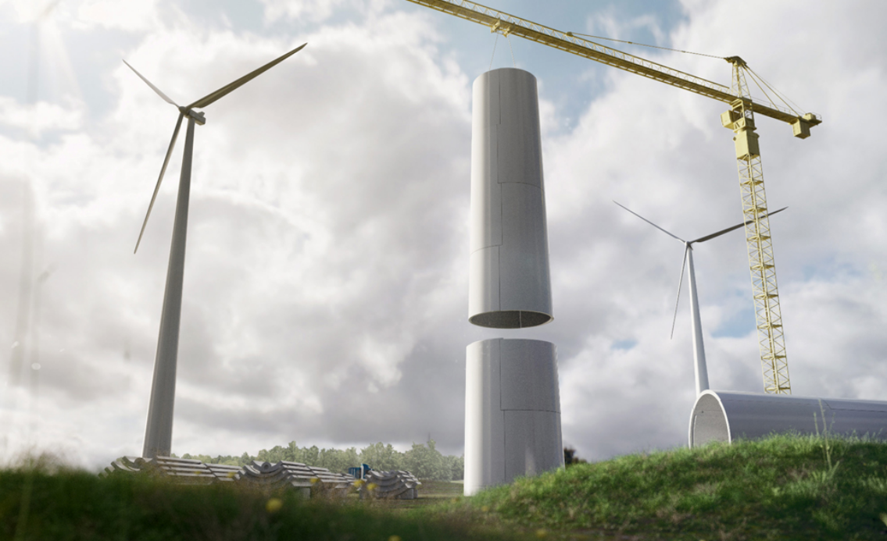
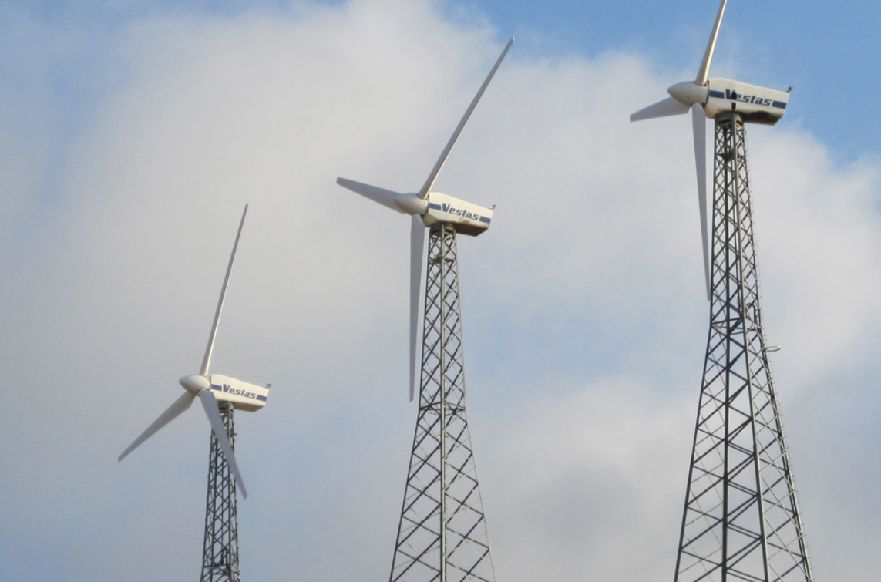
Tower
Modern WTGs are installed on tubular towers and lattice towers
Height of tower is decided based on designed value of wind speed and dimensions of rotor
Higher the turbine capacity, large the rotor

Slide 72
Merits
It is available free of cost in nature.
It is non-polluting
It is non-depleting
It can run a generator or a water pump.
Demerits
(i) It is available in small amount, depending on wind speed. It is fluctuating type and depends on wind speed.
(ii) It is suitable where wind speed is sufficiently high (coastal area).
(iii) The size of wind farm has to be large.
(iv) The wind direction keeps on changing.
(v) Maintenance cost of windmills is high.

Slide 73
Energy storage
If storage devices are not available: generated electricity must be constantly transmitted and utilized.
Large scale storage of energy which can be quickly converted to electrical form, help to handle fast changing loads.
Common storage methods:
Pumped storage
Compressed air storage
Heat storage
Hydrogen gas storage
Batteries
Flywheels
Capacitors

Slide 74
Pumped storage scheme
Consists of upper and lower reservoirs and reversible turbine-generator set, which can also be used as motor-pump set

Slide 75
Used in places where sufficient hydrogeneration is not available.
Peak load handling capability
Pumped storage acts as conventional hydroelectric plant during peak load periods when production is highest.
During peak, turbine is driven by water from upper reservoir
During light load, water in lower reservoir pumped back to upper.
Generator change to synchronous motor mode, drives turbine and act as pump.
Motoring mode: power supplied by main power grid
Analogous to battery charging
Pumped storage plant shaves the peak and fills the trough of load demand curve.

Slide 76
Compressed air storage

Slide 77
Compressed air energy storage
CAES decouples the compression and expansion cycle of a conventional gas turbine and stores the energy in the form of the elastic potential energy of CA.
In low demand period, energy is stored by compressing air in an air tight space
Compressed air can be stored in natural underground caverns/old mines
Energy stored equals volume of air multiplied by pressure.
At time of need, compressed air is mixed with gas fuel (or pass high pressure air through a heating system) to run turbine
And the turbine is connected to a generator to produce electricity
Disadvantage: much of energy used in compressing air appears in form of heat and get wasted.

Slide 78
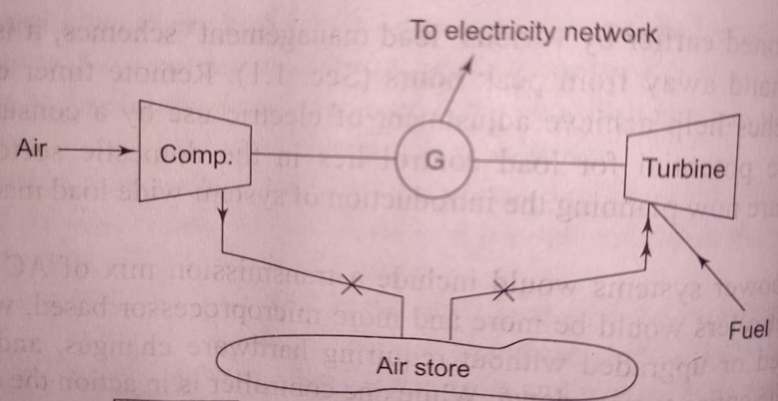
Compressed air energy storage

Slide 79
Heat storage
Thermal Energy Grid Storage (TEGS) involves storing excess electricity as heat until it is needed back on the grid.
The projected cost is also similar to pumped hydroelectric storage, but without geographic constraints.
Here, excess electricity (for example, solar power in the middle of the day) is converted to heat using resistance heaters.
This heat is stored in a storage medium at high temperature to preserve its usefulness
Then, when more electricity is needed (at night) the storage medium is used to run a heat engine that generate electricity

Slide 80
The heating elements glow and radiate heat to the storage medium or heat transfer fluid
The fluid/medium is transported from the cold tank, through the heater where it is raised to a high temperature in the hot tank
The hot fluid is then stored in a refractory, insulated tank
Since surface area controls the heat loss, a large tank naturally looses heat more slowly, as a fraction of its capacity
When electricity is needed, the storage fluid is pumped out of the hot tank and through a heat engine
The most widely used heat engines are turbines, such as the steam turbines used in conventional power plants. Multi-junction photovoltaic (MPV) system are also used.

Slide 81
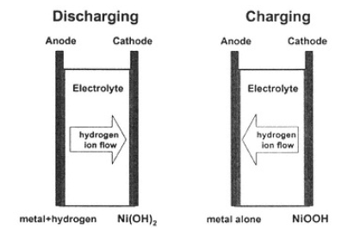
Battery Storage
Batteries produce electricity by causing a chemical reaction in the presence of an electrolyte
Batteries are stacked, to produce modules with higher voltages
Batteries store energy by having electric flow through them in the opposite direction, forcing ions in the other direction
Cycling and lifetime are a major concern for battery application to distributed generators.
Lead-acid batteries are by far the most popular and widely used type of battery, using lead as the plates and an acid as the electrolyte.
Nickel-metal hydride batteries are a promising commercial technology due to their higher energy density

Slide 82
Lithium-ion batteries are normally targeted at small applications. (rocking chair battery technology)
Reversible fuel cells are a type of battery, (in the sense that they store energy chemically). They use electricity to produce hydrogen and oxygen from water (through electrolysis) for storage.
Superconducting Magnetic Energy Storage (SMES)
SMES systems store energy in a superconducting magnetic coil immersed in a very cold liquid such as liquid helium, contained in a highly insulated thermal bottle.
Power is stored in a SMES by impressing a circulating DC electric current in the coil magnetically and withdrawn through reversal of the process.
SMES is a very expensive way to store power

Slide 83
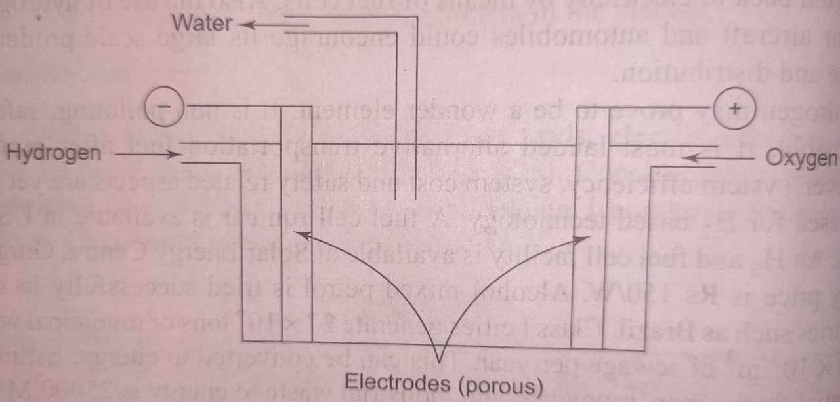
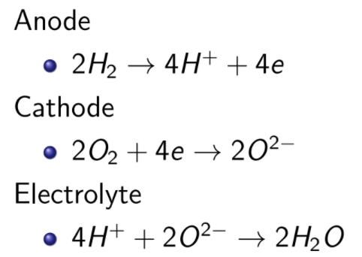
Fuel cells
Converts chemical energy to electrical energy by electrochemical reaction with no intermediate combustion cycle
One electrode continuously supplied with fuel (H₂) and the other with an oxidant (usually oxygen).
The fuel diffuses through porous metal electrode (Ni)
Electrode has catalyst deposited around the pores, aids absorption of H₂ on its surface
Electrolyte-concentrated phosphoric acid

Slide 84
Capacitor energy storage
Stores energy by maintaining an electric field between two conducting plates
The field will maintain itself even if the inducing source is removed
Power can be withdrawn by connecting the capacitor to an electrical pathway
Capacitors are often used for minor short-term energy storage needs in appliances and stabilization devices
However, they are not used for electric power storage applications, because they store only about 1/100 to 1/25 the power of lead-acid batteries
Super capacitors have 20 to 1,000 times the energy storage capability of traditional capacitors, are built using novel materials
The power density of capacitors is extremely high they can release all their power nearly instantly.
Supercapacitors improve storage density through the use of a nano porous material

Slide 85
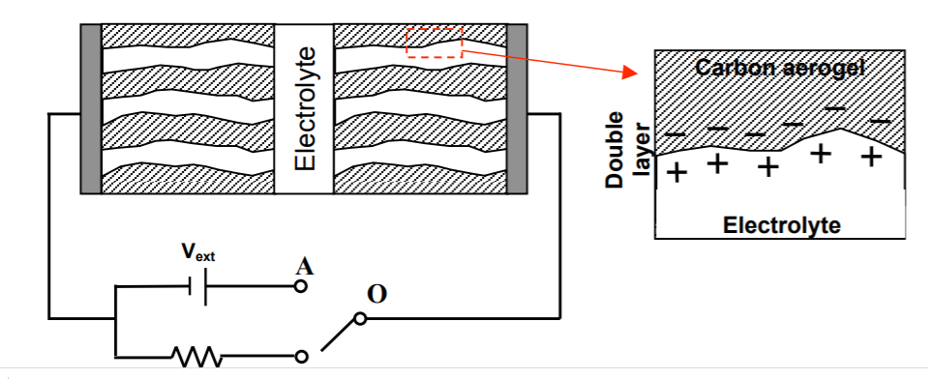
Two very high surface area porous electrodes are soaked in electrolyte. The charge is stored in electrochemical double layers.

Slide 86
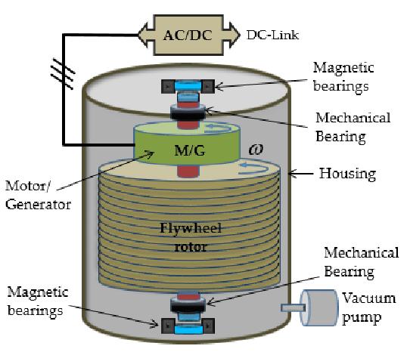
Flywheel
Energy is stored in the form of Kinetic energy( K.E.) in the rotating mass of a rapidly spinning flywheel
Flywheel is driven by an electrical machine which can work as a motor or generator
When machine acts like a motor, it exerts a positive torque to the flywheel, increases its speed and reaches a maximum velocity storing K.E.
For releasing the energy electrical machine which acts as a generator, applies a negative torque to the flywheel and energy is pumped back to the source

Slide 87
Types of Loads
General nature of load is characterized by load factor, demand factor, diversity factor power factor, utilization factor, etc.
Various types of loads on the power system are :
Domestic load: Domestic load consists of lights, fans, refrigerators, heaters, television, small motors for pumping water etc.
Commercial load: Commercial load consists of lighting for shops, fans and electric appliances used in restaurants etc. This class of load occurs for more hours during the day as compared to the domestic load.
Industrial load: Industrial load consists of load demand by industries. The magnitude of industrial load depends upon the type of industry.
Irrigation load: This type of load is the electric power needed for pumps driven by motors to supply water to fields.

Slide 88
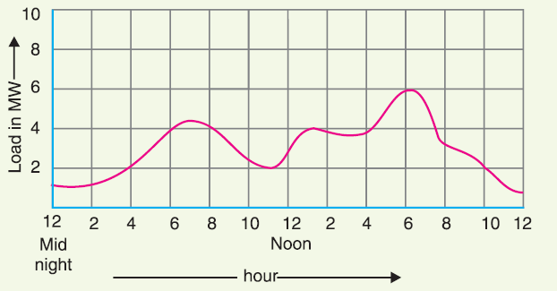
Load curve
The curve showing the variation of load on the power station with respect to (w.r.t) time is known as a load curve.
The monthly load curve can be obtained from the daily load curves of that month.
The monthly load curve is generally used to fix the rates of energy.
The yearly load curve is obtained by considering the monthly load curves of that particular year.
The yearly load curve is generally used to determine the annual load factor.
Load variations during the whole day are recorded half-hourly or hourly and are plotted against time on the graph known as daily load curve
Load curve indicates at a glance the general character of the load that is being imposed on the plant

Slide 89
NOTE
The daily load curve shows the variations of load on the power station during different hours of the day.
Units generated/day = Area (in kWh) under daily load curve.
The highest point on the daily load curve represents the maximum demand on the station on that day.
The area under the daily load curve divided by the total number of hours gives the average load on the station in the day.
Ratio of the area under the load curve to the total area of rectangle in which it is contained gives the load factor.
The load curve helps in selecting the overall capacity of generating units and helps in preparing the operation schedule of station

Slide 90
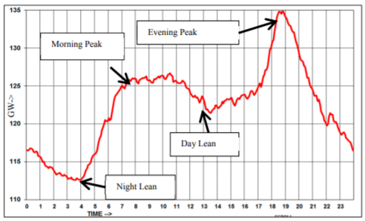
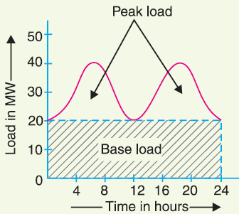
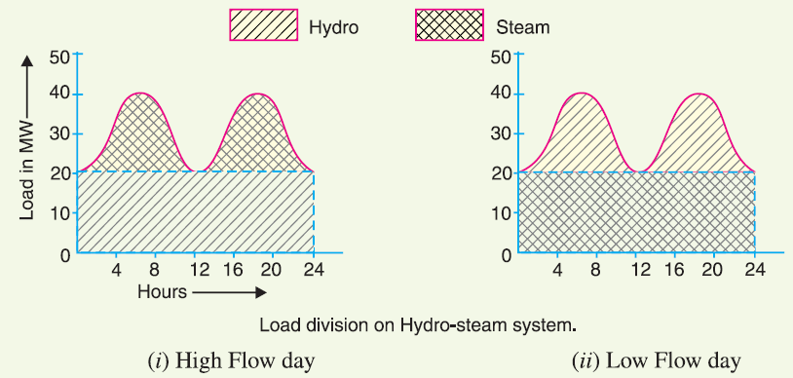

Typical Indian daily load curve

Slide 91


Typical Indian daily load curve
Peak demand met trend of Uttar Pradesh in the month of Diwali for the last two years
All India daily demand trend for different months of each season for 2014 and 2015

Slide 92

Connected load (C.L): It is the sum of continuous ratings of all the equipment connected to supply system.
Maximum demand (M.D): It is the greatest demand of load on the power station during a given period.
M.D helps in determining the installed capacity of the station
M.D is generally less than the connected load
Demand factor (De.F): It is the ratio of maximum demand on the power station to its connected load
De.F is vital in determining the capacity of the plant equipment
The average of loads occurring on the power station in a given period (day or month or year) is known as average load or average demand
Load factor(L.F): The ratio of average load to the maximum demand during a given period is known as load factor

Slide 93


L.F is always less than one because average load is smaller than the maximum demand.
daily load factor, monthly load factor or annual load factor
The load factor plays key role in determining the overall cost per unit generated. Higher the load factor of the power station, lesser will be the cost per unit generated.
Diversity factor (D.F): The ratio of the sum of individual maximum demands to the maximum demand on power station is known as diversity factor
M.D on the power station is always less than the sum of individual maximum demands of the consumers (D.F>1)

Slide 94

Plant capacity factor(p.c.f): It is the ratio of actual energy produced to the maximum possible energy that could have been produced during a given period
The plant capacity factor is an indication of the reserve capacity of the plant
If the maximum demand on the plant is equal to the plant capacity, then load factor and plant capacity factor will have the same value
Plant use factor(p.u.f): It is ratio of kWh generated to the product of plant capacity and the number of hours for which the plant was in operation
When the load elements of a load curve are arranged in the order of descending magnitudes, the curve thus obtained is called a load duration curve.

Slide 95

It readily shows the number of hours during which the given load has prevailed.
The area under the load duration curve is equal to that of the corresponding load curve.

Slide 96

Problem

Slide 97



Slide 99


Slide 101

Problem

Slide 102



Slide 104


Slide 106
Smart grid
Modern Power System Characteristics:
Wide geographical spread
Large number of interconnections
Rapid growth in the demand of electricity
Power system components are being operated closer to their designed limits
High penetration of renewable energy sources
Competitive electricity market

Slide 107
Smart grid
Smart Grid refers to the integration of digital technology into the existing electrical grid, enabling two-way communication between all grid components.
Additional features:
Optimize assets and operate more efficiently
Reduce frequency and duration of outages
Resist physical and cyber attack
Provide improved power quality
Accommodate renewable energy and energy storage options
Enable new products, services, and markets

Slide 108

A Smart Grid is one that incorporates information and communications technology into every aspect of electricity generation, delivery and consumption in order to minimize environmental impact, enhance markets, improve reliability and service, reduce costs and improve efficiency.

